Slide 1
UVEAL TRACT DISEASES
DR SALAH ZUHAIR AL-ASADI
FRCS, FIBMS, FICO, FACS

Slide 2
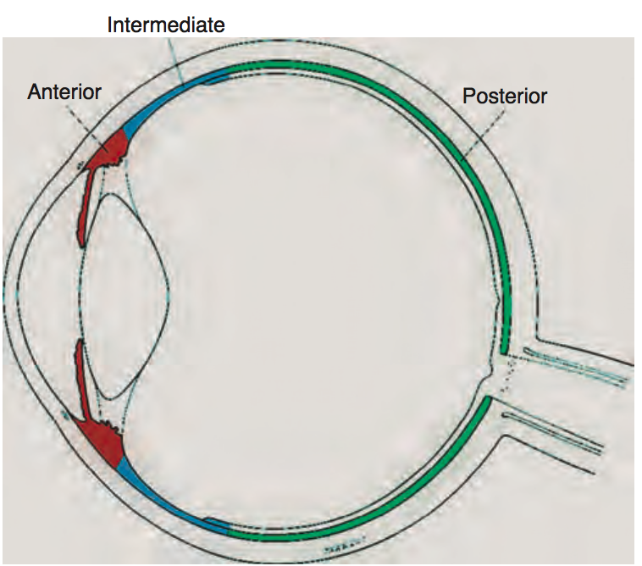
classification
Anterior: ant. chamber the primary site of inflammation.
Intermediate: primarily vitreous inflammation; includes pars planitis.
Posterior: retina and/or choroid.
Panuveitis: all uveal structures are involved.

Slide 3
clinical classification
Onset: sudden or insidious.
Duration: limited (3months or less) or persistent.
Clinical course: acute (of sudden onset and limited duration), recurrent (repeated episodes separated by untreated inactive periods), or chronic (persistent duration, with relapse less than 3 months after discontinuation of treatment). Remission is defined as inactivity (no visible cells) for 3 months or longer.

Slide 4
Anterior Uveitis
Acute: HLA-B27
Chronic:
idiopathic ( about 50 %)
infectious ( eg. Herpes Zoster)
non-infectious (TB, sarcoid, SLE, ..etc)
Mesquerade ( lymphoma)

Slide 5
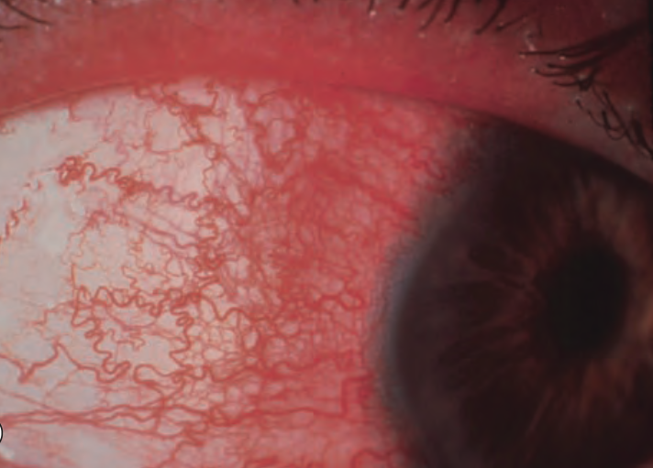
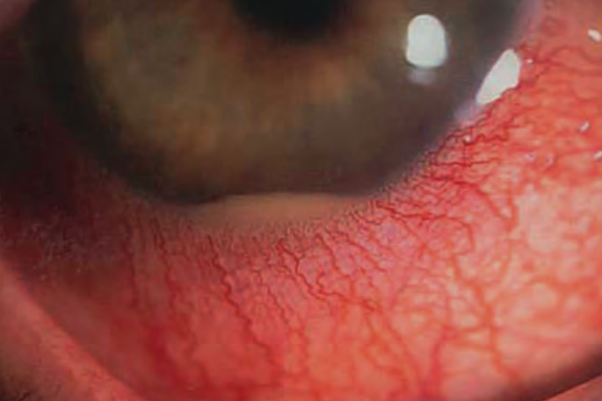
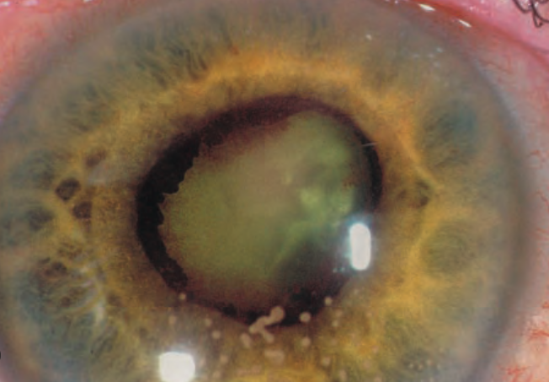
clinical features
Acute onset of ocular pain + photophobia + tearing
Decreased vision
Circumcorneal conjestion
Miosis, Anterior chamber cells + hypopyon + fibrinous exudates
Keratic precipitates
Posterior synechiae + iris atrophy

Slide 6
investigations
CBC
ESR CRP
ACE
TB serology
CXR
OCT, Ocular U/S

Slide 7
treatment
steroids
topical ( drops)
periocular ( subconjunctival )
intravitreal
systemic
NSAIDs ( naproxen )
antimetabolites ( MTX )

Slide 8
clinical examples
Ankylosing spondylitis
reactive arthitis ( Reiter syndrome)
psoriatic arthritis
Fuch’s uveitis syndrome
uveitis in juvenile idiopathic arthritis
uveitis in bowel disease ( UC, Crohn dis)
uveitis in renal disease ( IgA nephropathy)

Slide 9
intermediate uveitis
involves the vitreous primarily, then pars planitis and cyclitis
clinical features:
insidious onset of decreased vision, floaters + NO pain
KPs, Vitreous cells, periphlebitis, snowbanking, CME, cataract and even RD
inv exclude: MS, sarcoid, TB, Lyme dis, Syphilis

Slide 10
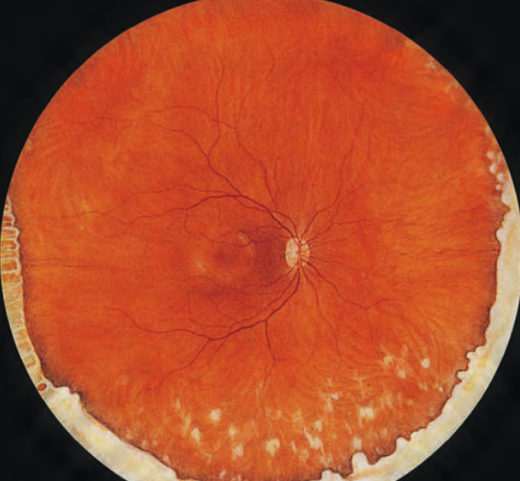
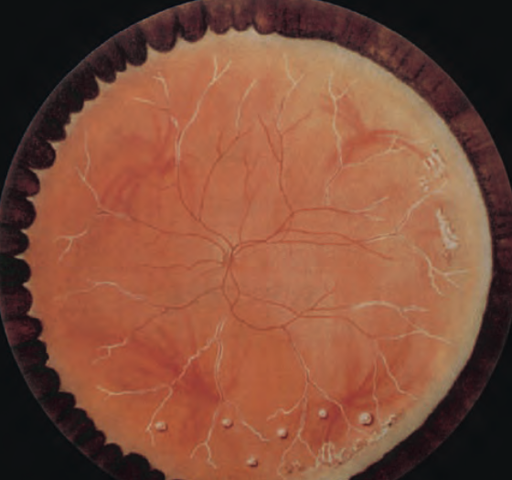
treatment
steroids ( topical, regional, subtenon, NSAIDs, cryotherapy, systemic steroids, laser Rx, intravitreal steroids, immunosuppressive agents, surgery)

Slide 11
Examples of Uveitis

Slide 12
sympathetic ophthalmitis
bilateral granulomatous panuveitis occurring after penetrating trauma; uveal prolapse +/- trauma. st postop intraocular surgery.
Presentation in trauma-induced cases between 2 wks - 3 mths after initial injury in 65%. incidence about 0.2–0.5% after injury clinical features:
hx trauma
exciting eye : irritable
sympathizing eye: irritation, blurred vision, photophobia+ loss of accommodation
Ant. uveitis (both eyes) mild or severe and usually granulomatous. severity may be asymmetrical
Fundus: multifocal choroidal infiltrates in midperiphery

Slide 13
treatment
Enucleation of a severely injured eye in the first week or so following injury considered for an injured eye with a hopeless visual prognosis.
Steroids are the basis of treatment. High dose oral prednisolone for several months, gradually tapered according to response. Supplementary topical steroids and cycloplegics may be given for anterior uveitis, and peri- and intraocular steroids, including slow-release intravitreal implants, may facilitate reduced systemic treatment.
Immunosuppressives azathioprine, ciclosporin, MTX in resistant cases or as steroid- sparing agents.
Biological blockers (e.g. infliximab) may be considered.

Slide 14
Behçet Disease
idiopathic multisystem syndrome characterized by recurrent aphthous oral ulcers, genital ulceration+ uveitis
3rd decade, HLA B51, middle and far east
vasculitis of veins + arteries

Slide 15
ocular manifestations
Acute ant. uveitis: non-granulomatous with (mobile) hypopyon in relatively white eye
severe vitritis
retinitis + retinal vasculitis + optic disc edema and neovascularization

Slide 16
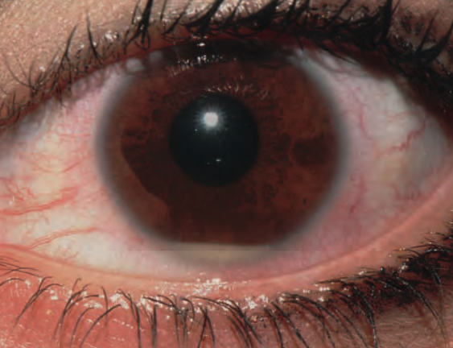
treatment
topical steroids
systemic steroids+ azathioprine
ciclosporin
infliximab
interferon alfa

Slide 17
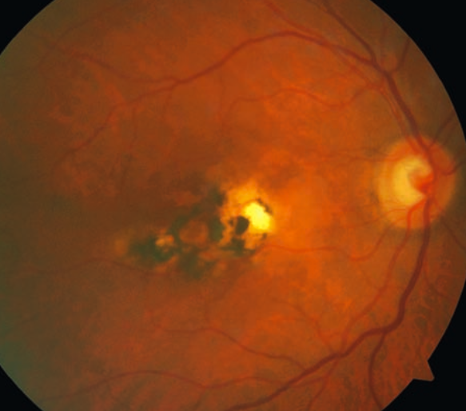
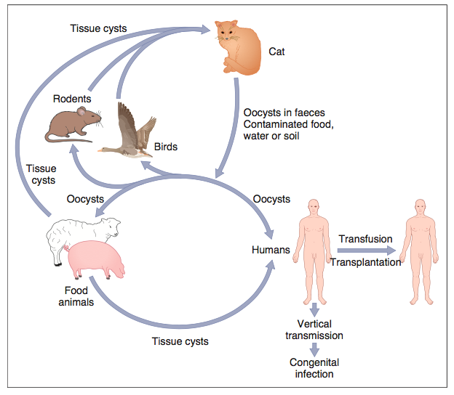
toxoplasmosis

Slide 18
clinical features
cong. toxoplasmosis, postnatal and acquired toxoplasmosis
ocular features: vitritis, uveitis, retinochroiditis, neuroretinitis
Rx: indicated in ACTIVE disease may include systemic prednisolone, pyrimethamine, sulphadiazine, azithromycon, co-trimazole, vancomycin

Slide 19
THANKS

